Slide 1
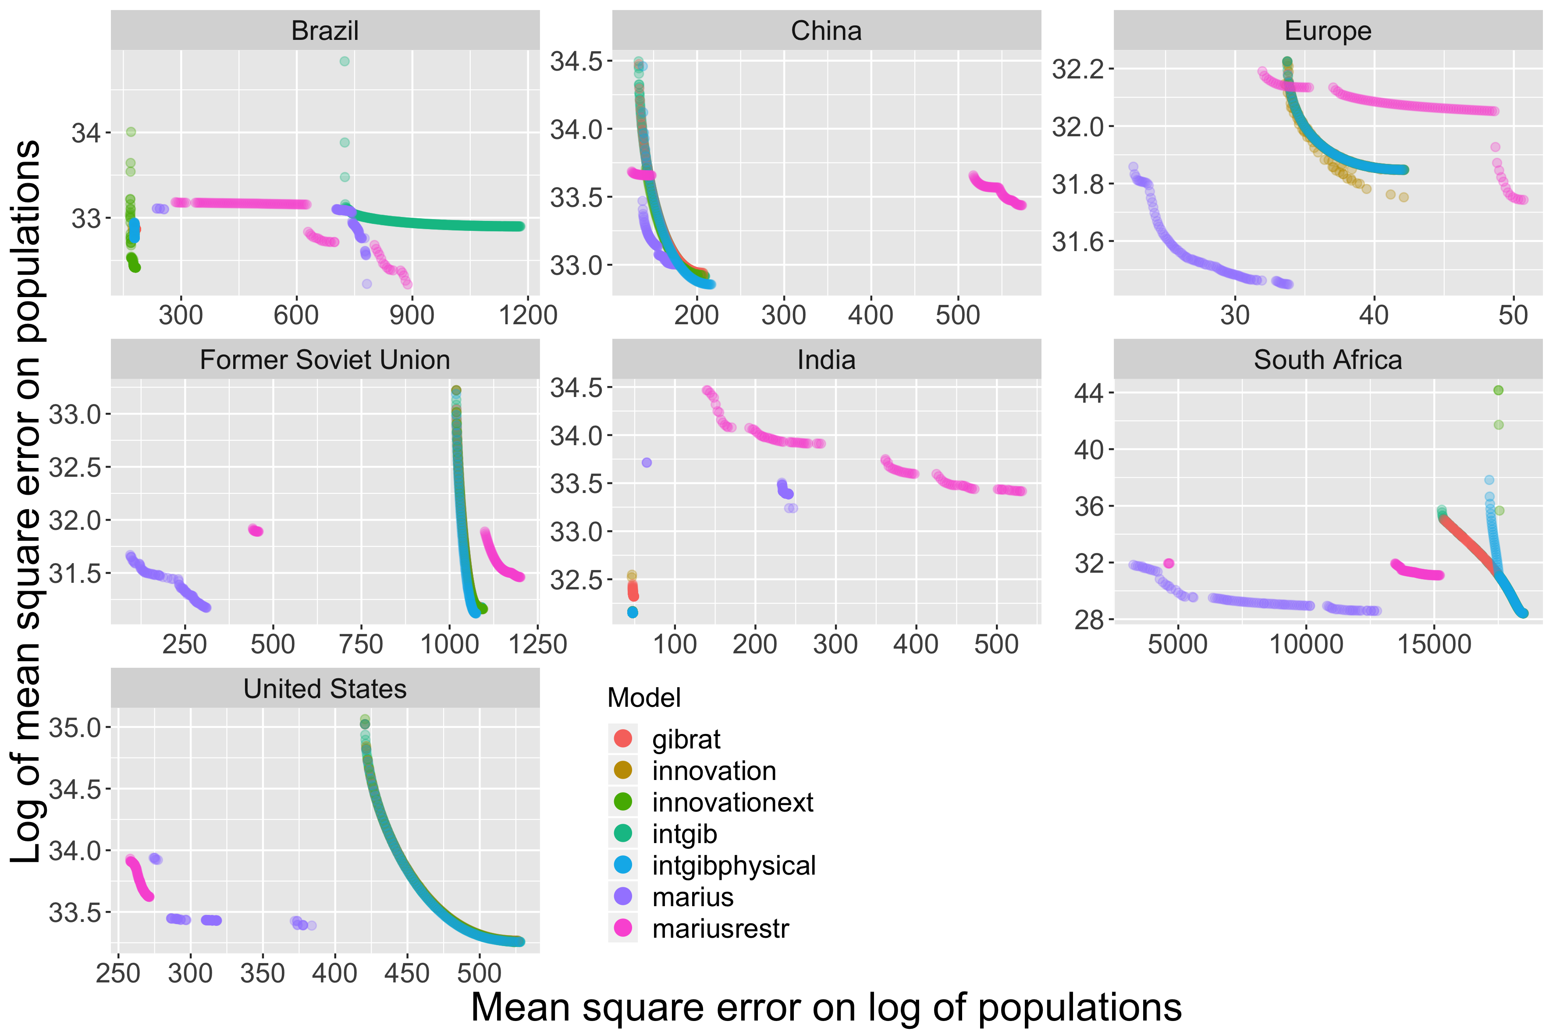
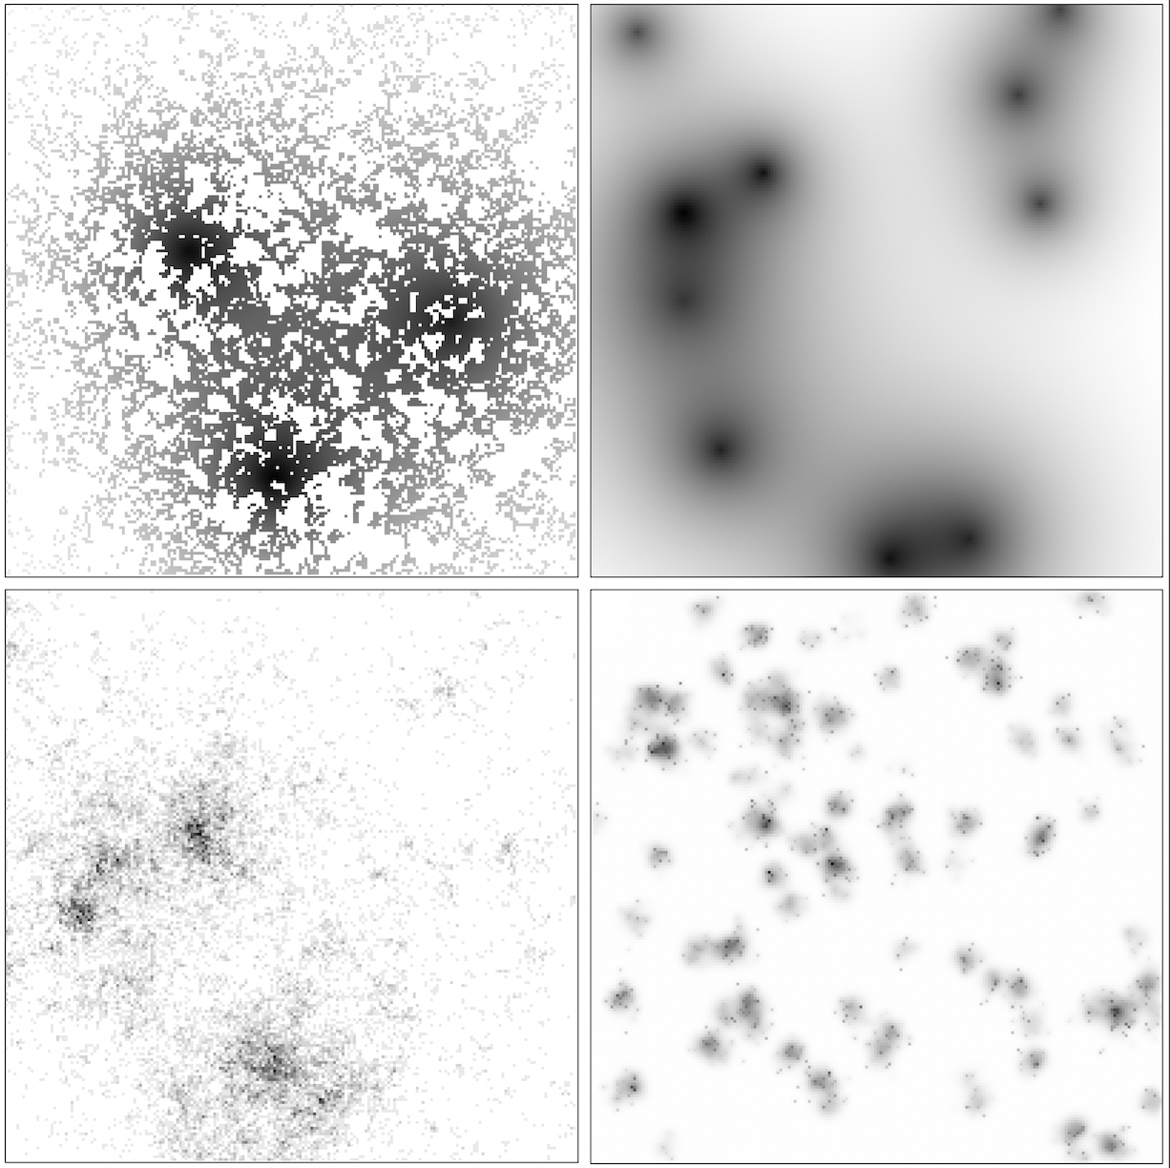
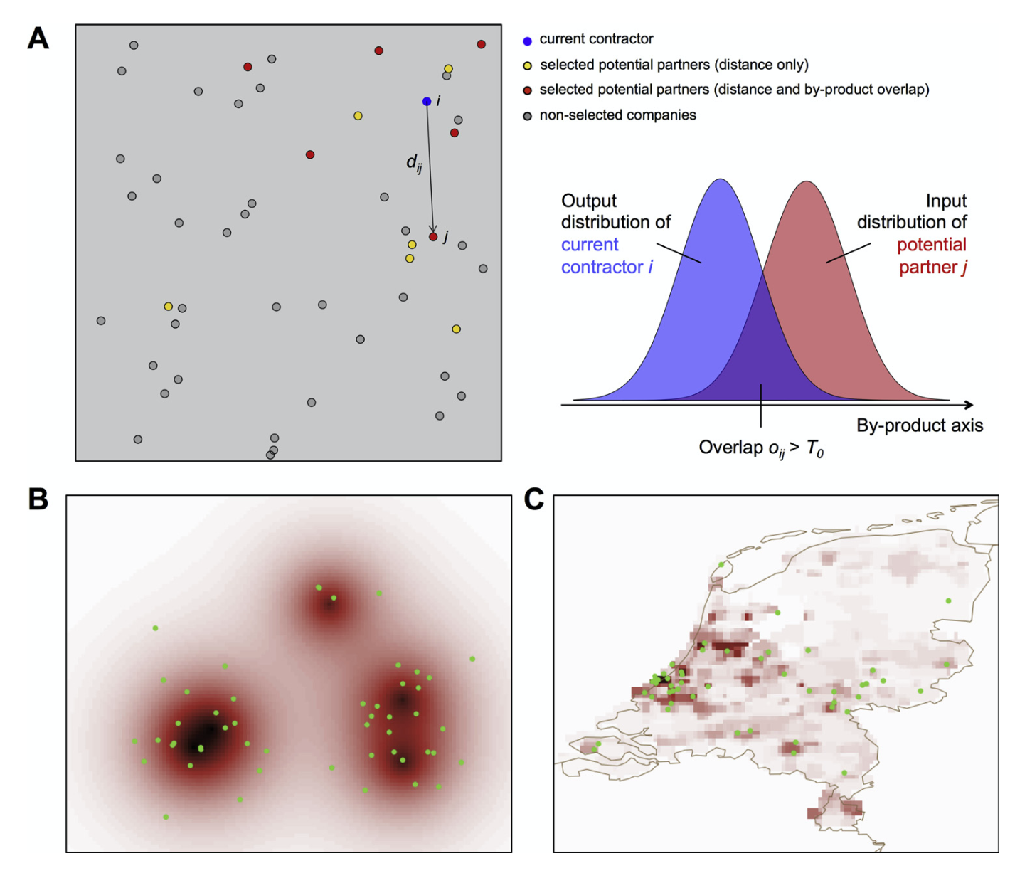
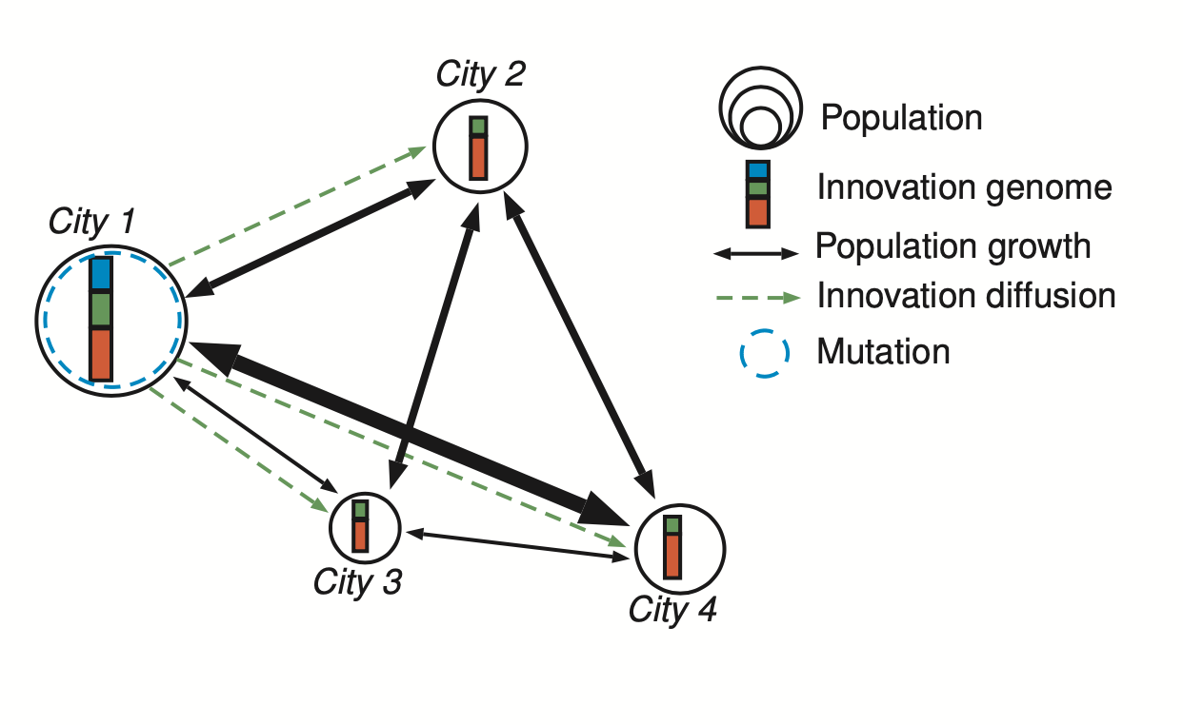
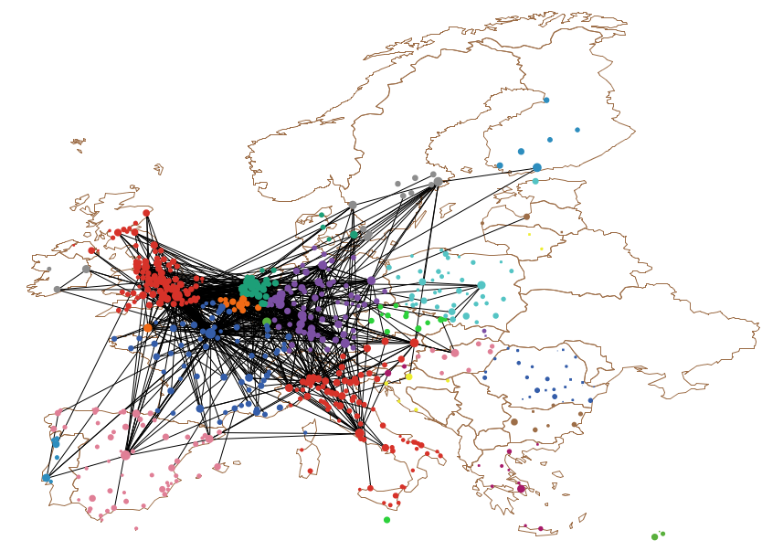
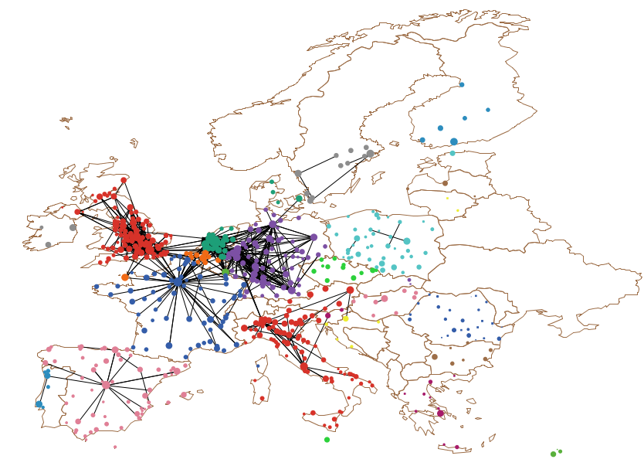
Evolutionary approach to systems of cities
Multi-modeling urban growth
Benchmark of urban morphogenesis models
Agent-based models for sustainability
Raimbault, J., Denis, E., Pumain, D. (2020) Empowering Urban Governance through Urban Science: Multi-Scale Dynamics of Urban Systems Worldwide. Sustainability, 12, 5954.
Raimbault, J. (2020). A comparison of simple models for urban morphogenesis. arXiv preprint arXiv:2008.13277.
Raimbault et al. (2020). A spatial agent based model for simulating and optimizing networked eco-industrial systems. Resources, Conservation and Recycling, 155, 104538.
Urban firm networks
generative model
Raimbault, J., Zdanowska, N., Arcaute, E. (2020). Modeling growth of urban firm networks. arXiv preprint arXiv:2009.05528.
Presented at NetSci 2020.
Urban evolution model
Raimbault, J. (2020). A model of urban evolution based on innovation diffusion.
Artificial Life Conference Proceedings 2020 NO. 32, 500-508

Slide 2
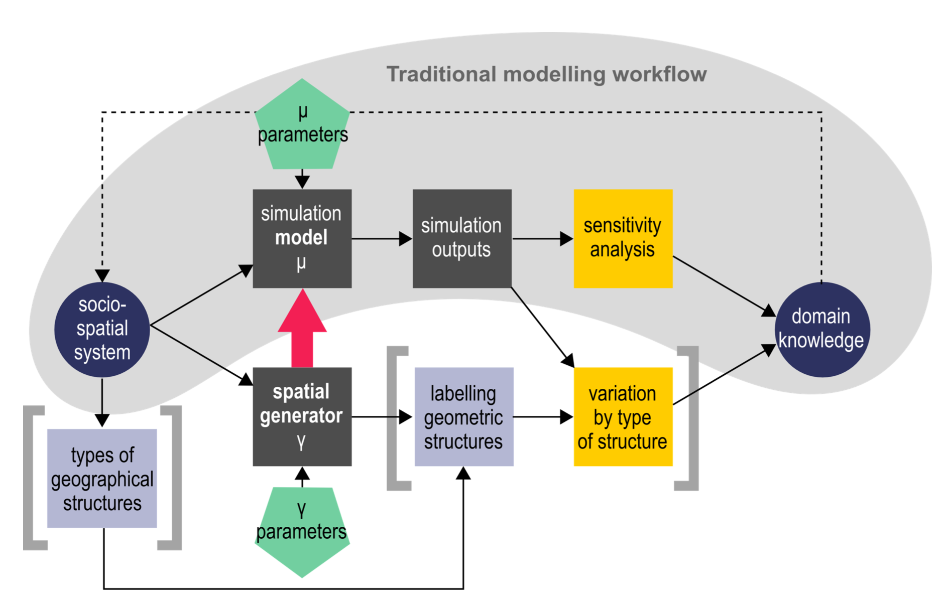


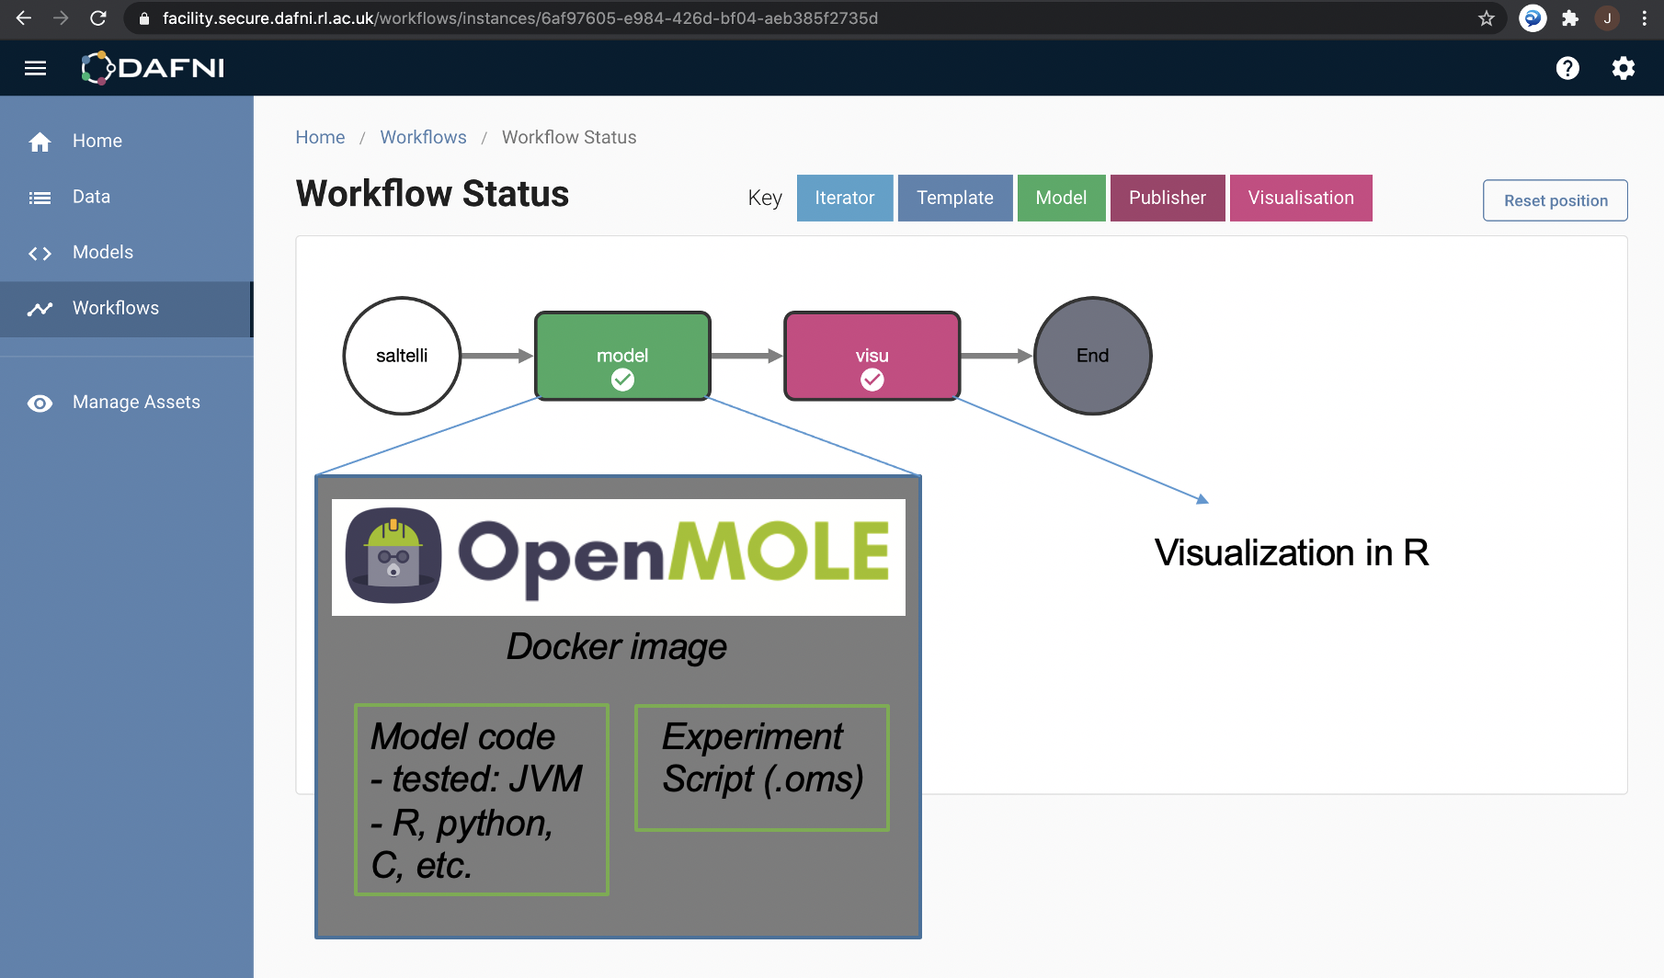
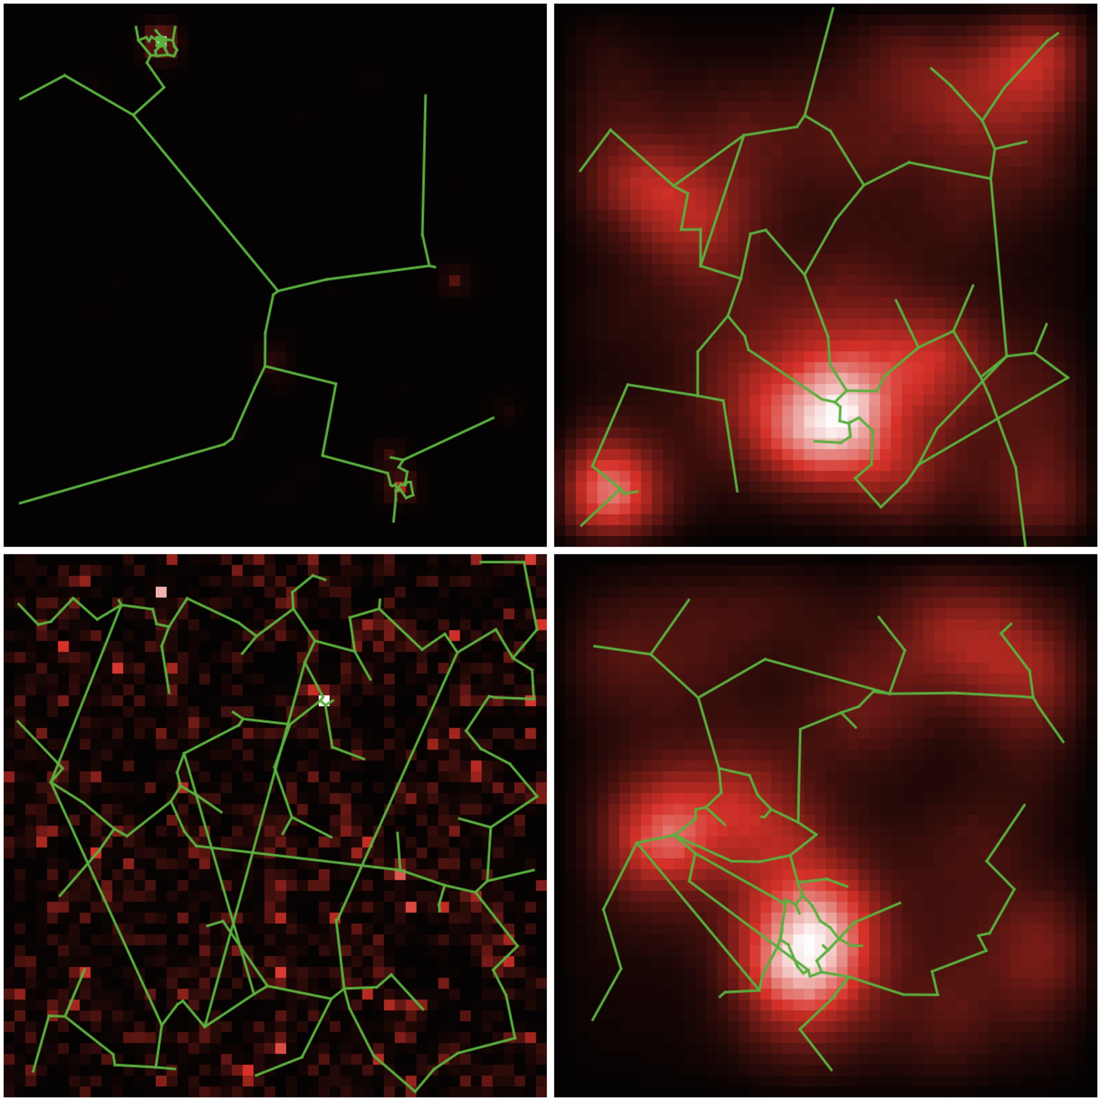
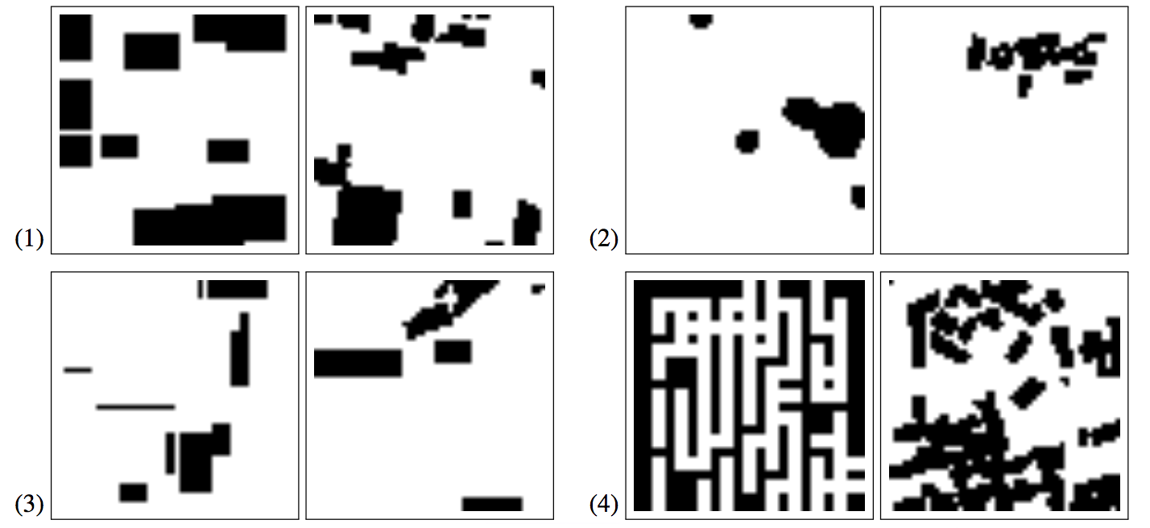
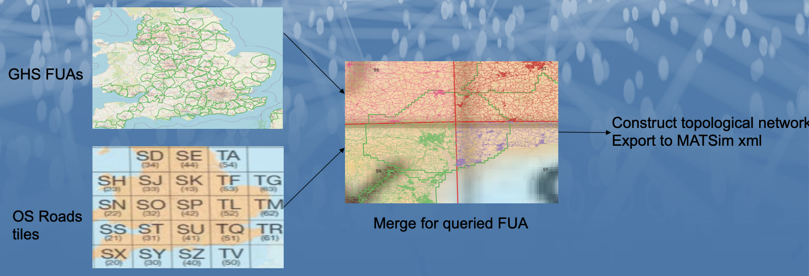
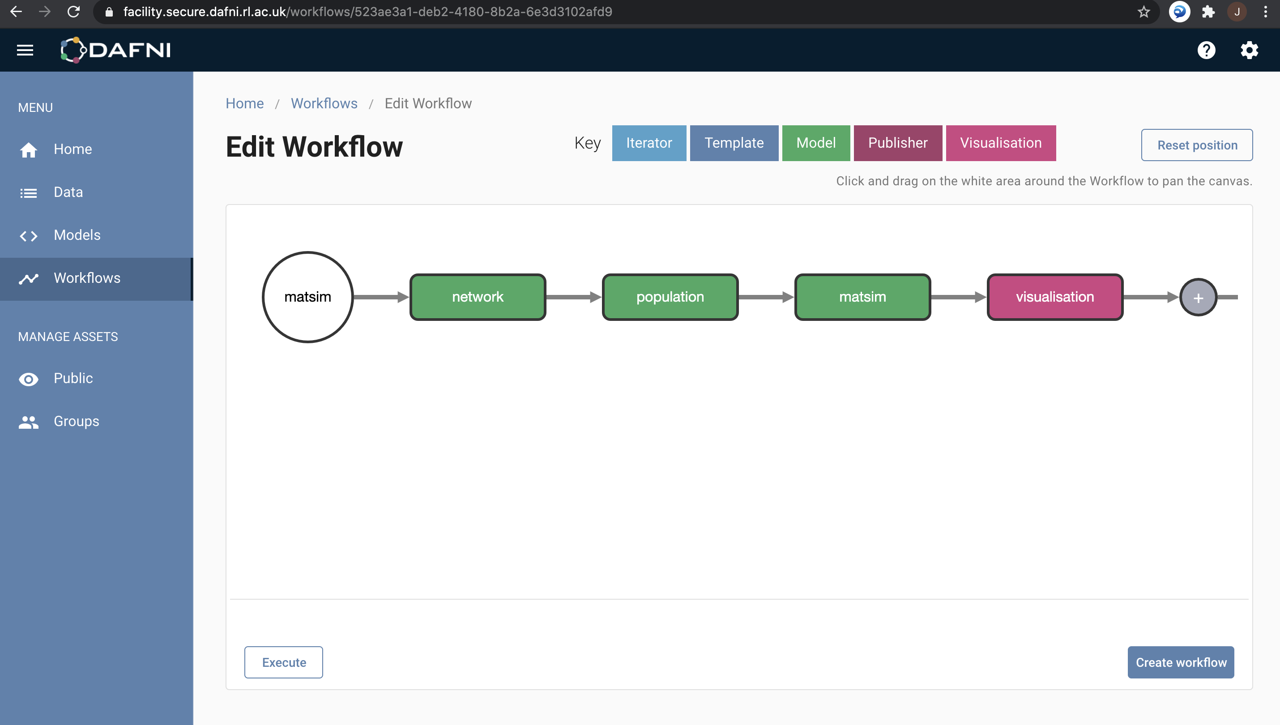
Model coupling and validation with high-performance computing
Spatial sensitivity analysis and synthetic data
Model integration and coupling in HPC workflow engines
Workflow engine integration
providing OpenMOLE model validation methods
to the DAFNI infrastructure
Raimbault, J., Cottineau, C., Le Texier, M., Le Nechet, F., Reuillon, R. (2019). Space Matters: Extending Sensitivity Analysis to Initial Spatial Conditions in Geosimulation Models. Journal of Artificial Societies and Social Simulation, 22(4).
Raimbault, J., Perret, J., & Reuillon, R. (2020). A scala library for spatial sensitivity analysis. GISRUK 2020 Proceedings, 32.
Model coupling: building a four-stage transportation model by coupling MATSim (transport), SPENSER (population), QUANT (Spatial interactions) with application to health indicators in public transport
Raimbault, J., Perret, J. (2019). Generating urban morphologies at large scales. In Artificial Life Conference Proceedings (pp. 179-186).
Raimbault, J. (2019). Second-order control of complex systems with correlated synthetic data. Complex Adaptive Systems Modeling, 7(1), 1-19.

Slide 3
Raimbault, J., Cottineau, C., Le Texier, M., Le Nechet, F., Reuillon, R. (2019). Space Matters: Extending Sensitivity Analysis to Initial Spatial Conditions in Geosimulation Models. Journal of Artificial Societies and Social Simulation, 22(4).
Raimbault, J., Perret, J., & Reuillon, R. (2020). A scala library for spatial sensitivity analysis. GISRUK 2020 Proceedings, 32.
Raimbault, J. (2019). Second-order control of complex systems with correlated synthetic data. Complex Adaptive Systems Modeling, 7(1), 1-19.
Raimbault, J., Perret, J. (2019). Generating urban morphologies at large scales. In Artificial Life Conference Proceedings (pp. 179-186).

